Slide 1



Alireza Yousefian Github: itsnyx
Mohammad Hossein Pour Github: M-hoseinpour
Hossein Hamzehzadeh Github: Hamzeh01

Slide 2
Smart Contracts

Slide 3
References & prerequeres
A Comprehensive Introduction to Blockchain[Github]
WEB3 Swap[Github]

Slide 4


Introduction to smart contracts
Brief explanation of smart contracts📱
Importance in blockchain technology 🔗

Slide 5
Access Control in smart contract
Access control with ownable contract

Slide 6

Overview of the Ownable contract.⛏️
Explanation of the _owner variable and onlyOwner modifier.🕐
Demonstration of how ownership can be transferred.🚌

Slide 7

Integrating External Data with Chainlink
Introduction to Chainlink and its role in providing decentralized oracle services.
Explanation of the DataFeeds contract.
Mention of the AggregatorV3Interface for price feed interaction.

Slide 8
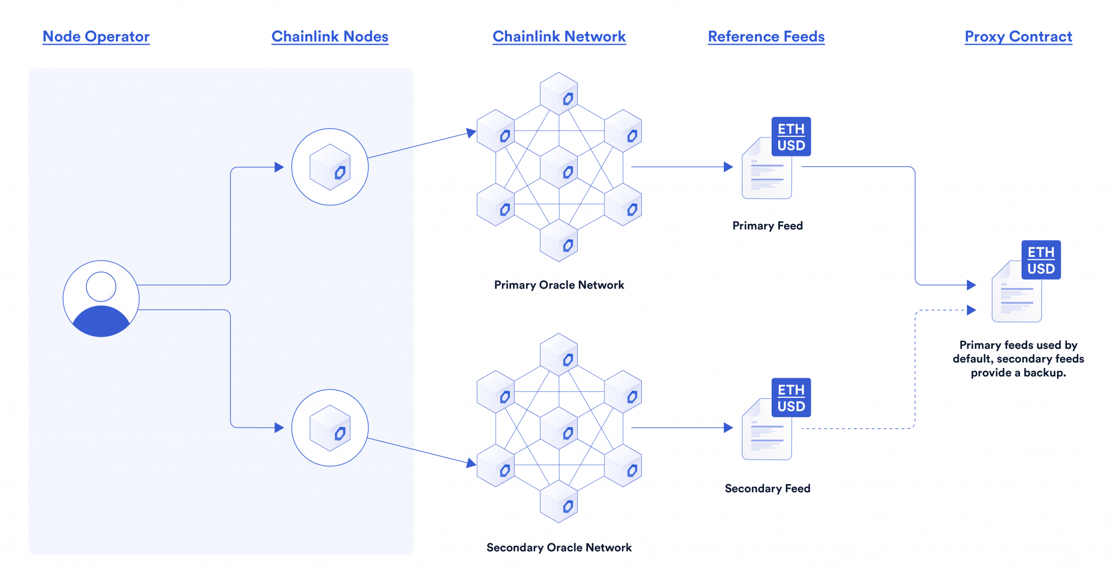
Price feed implementation

Slide 9
Utilizing price feed in token presale
How the price feed interacts with the Token Presale contract.🪙
Importance of accurate pricing in token-related operations.🫰
The role of the getBNBLatestPrice function.🧾

Slide 10
System architecture overview
Overall system architecture

Slide 11
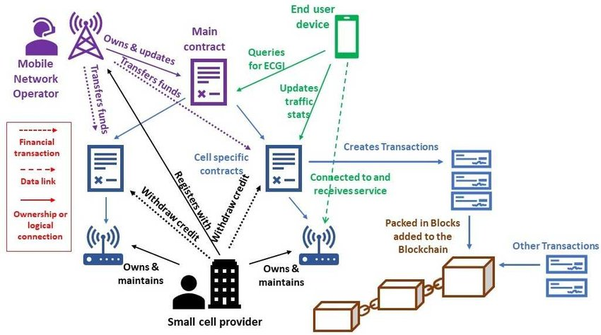
Overall system architecture

Slide 12
Security considerations
Ensuring Security in Smart Contracts

Slide 13
Smart Contract Security Features
TokenPresale Contract
Access Control🦾
Admin Functionality🙍‍♂️
Activation/Deactivation Mechanism🎭
Modifiers for Admin Functions
Ownable Contract
Ownership Transfer
OnlyOwner Modifier
DataFeeds Contract
Immutable Price Feed Address
Internal Function for Price Retrieval🔏

Slide 14
Best Practices for Secure Smart Contract Development
Immutable Contracts🧾
Access Control🛂
Use of Modifiers👻
External Dependency Considerations👾
Testing and Auditing🧪
Gas Limit Considerations⛽
Upgradeability Considerations⤴️

Slide 15
Web3 Presale

Slide 16
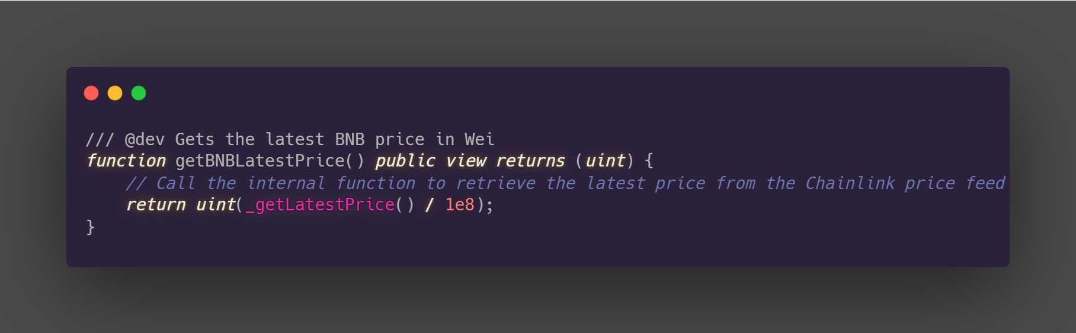
Retrieving the Latest BNB Price
The function calls the internal _getLatestPrice function to fetch the most recent price data.
The result is then converted to Wei by dividing it by 1e8, ensuring compatibility with Ethereum's base unit.

Slide 17
Participating in the Token Presale
Checks if the presale is currently active and if the participant's wallet is allowed.🧧
If it's the participant's first entry, calculates token amount from provided BNB and updates allocations.🧮
If the participant has already entered, calculates additional token amount, checks if the amount is acceptable, and updates allocations.✔️
Purpose: This function allows participants to enter the token presale, checking their previous participation and updating token allocations accordingly.

Slide 18
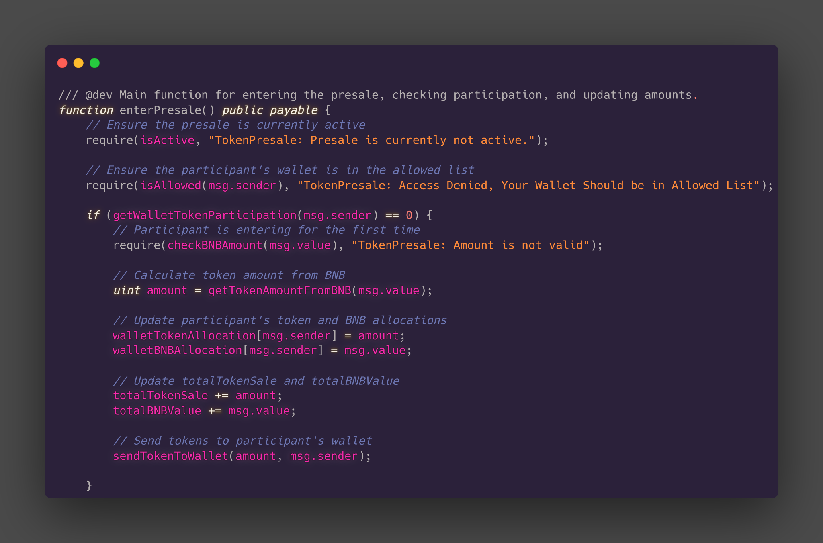
Participating in the Token Presale

Slide 19
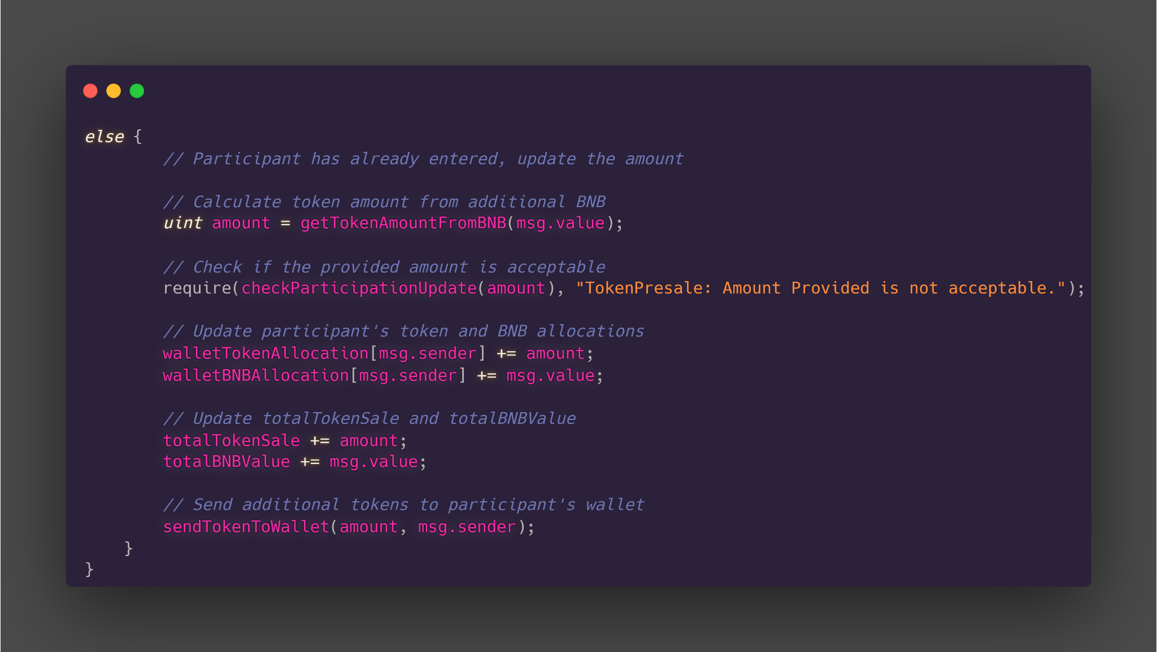
Participating in the Token Presale

Slide 20
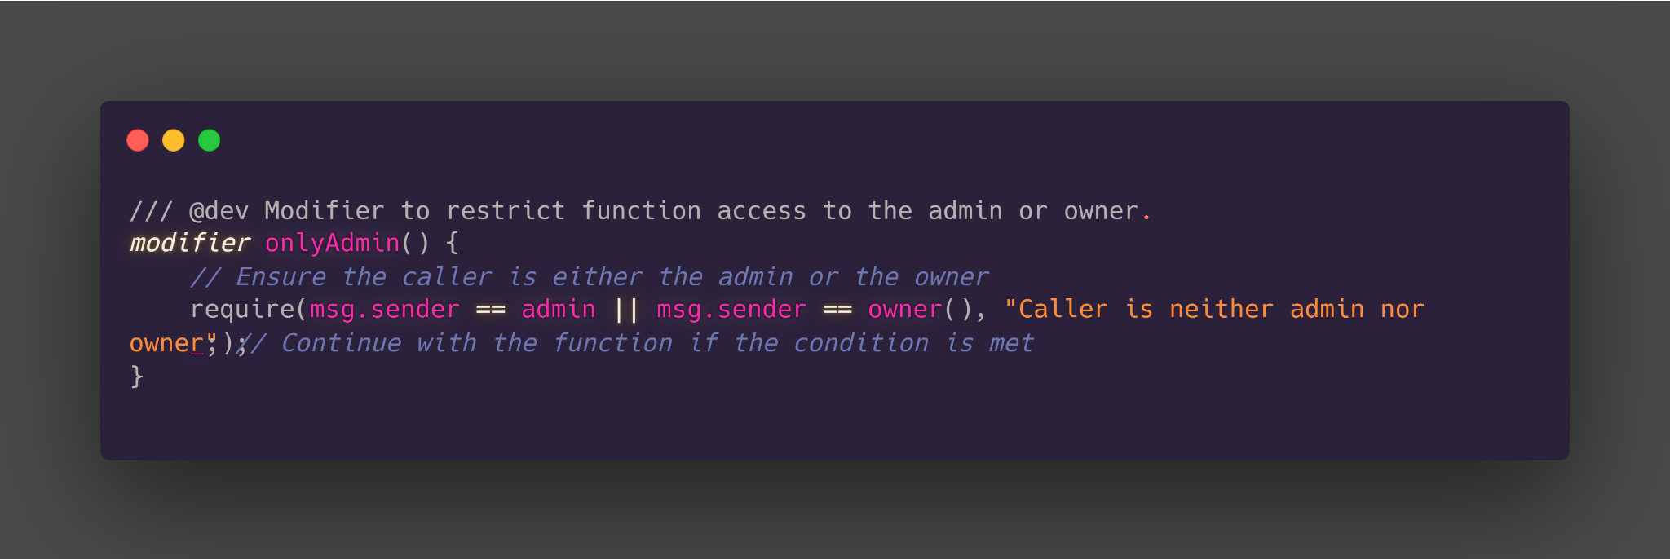
Admin Access Control
The modifier checks if the caller is either the admin or the owner of the smart contract.
If the condition is met, the function continues execution; otherwise, an error is thrown.

Slide 21
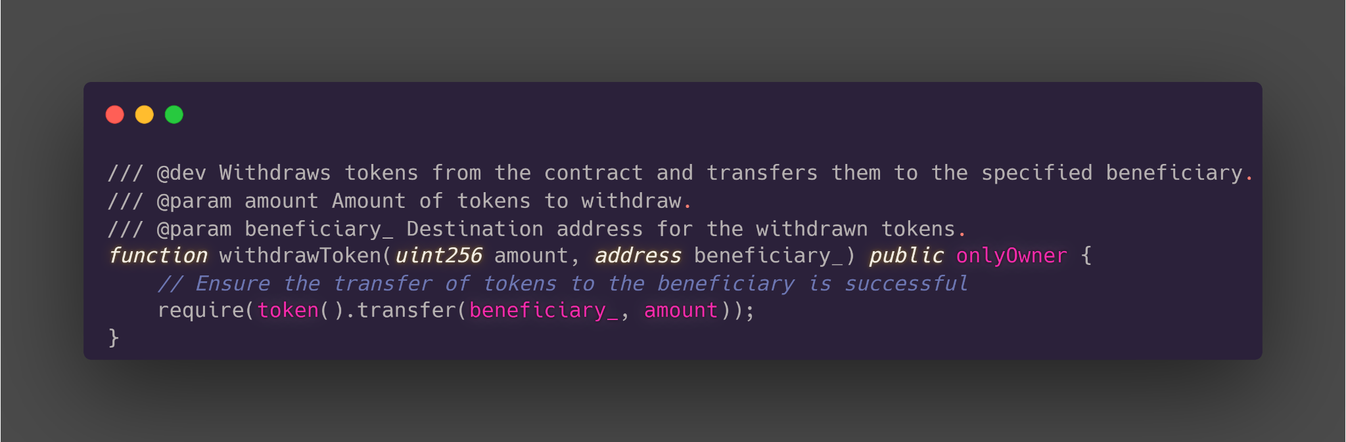
Token Withdrawal Functionality
The function takes two parameters: amount (the quantity of tokens to withdraw) and beneficiary_ (the address to receive the withdrawn tokens).
The withdrawal is contingent on the successful transfer of tokens to the specified beneficiary.

Slide 22
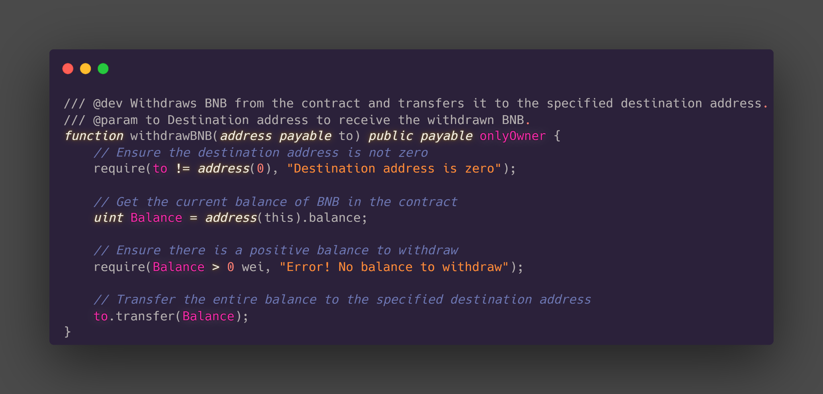
BNB Withdrawal Functionality
The function takes a parameter to (the address to receive the withdrawn BNB).
It ensures that the destination address is valid and not zero.
It checks that there is a positive BNB balance in the contract before initiating the transfer.

Slide 23
Conclusion and Q&A
Wrapping Up and Questions

Slide 24
Thank you!

